Slide 1

HOME CREDIT DEFAULT RISK
A Machine Learning approach
Made by: Heba Aladdin

Slide 2
CONTENT
Here’s what you’ll find in this presentation:
Business problem.
Value propasition.
Approach.
Key insights and findings.
Training ML models.
Results and conclusion
Github repository: https://github.com/HebaAladdin/Kaggle-home-credit-risk

Slide 3
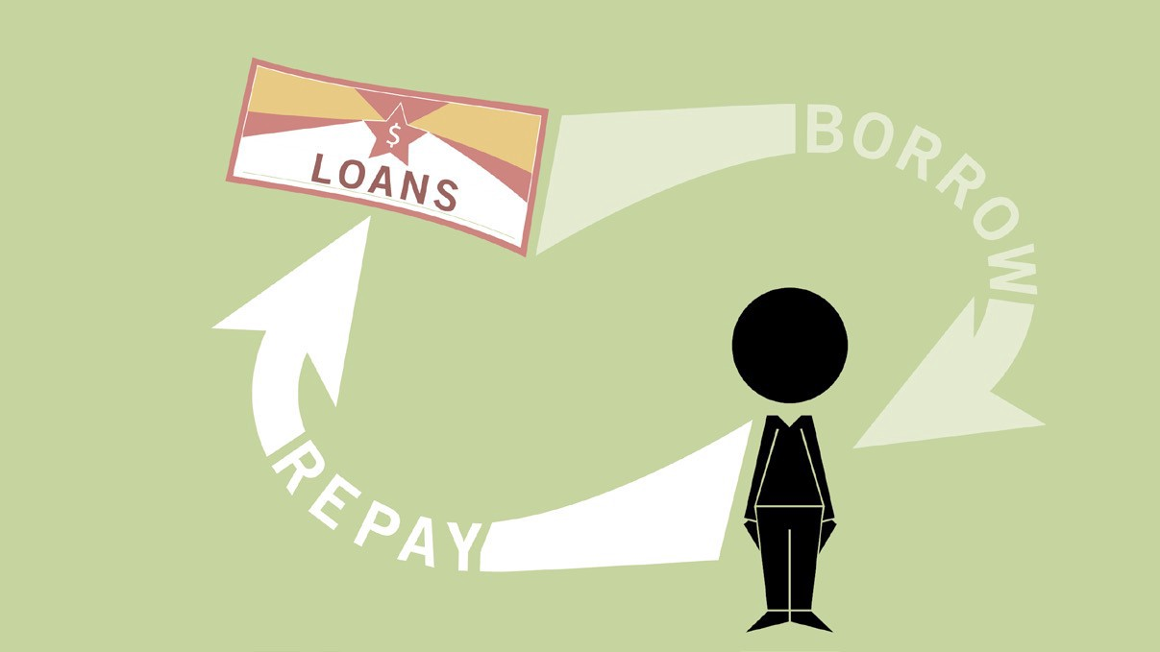
BUSINESS PROBLEM
Default risk is the chance that companies or individuals will be unable to make the required payments on their debt obligations. In other words, credit default risk is the probability that if you lend money, there is a chance that they won’t be able to give the money back on time.
Lenders and investors are exposed to default risk in virtually all forms of credit extensions. To mitigate the impact of default risk, lenders often impose charges that correspond to the debtor’s level of default risk. A higher level of risk leads to a higher required return

Slide 4
VALUE PROPOSITION
FASTER PROCESS
DECREASE EXPOSURE
INCREASE BORROWER BASE
INCREASE PROFIT
Shorter lending process
Decrease exposure that leanders are exposed to
Trust more applicants and unbanked population
Lend more gain more

Slide 5
APPROACH
01
02
03
MODELING
DATA ANALYSIS & EDA
FEATURE ENGINEERING & FEATURE SELECTION
Training machine learning models
Exploaring the dataset to find patterns and business insights

Slide 6
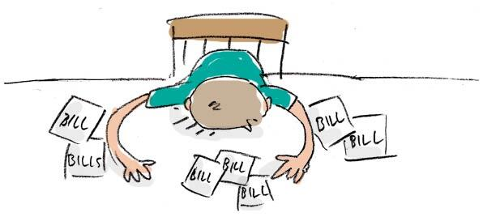
UNDERSTANDING THE PROBLEM
REPAY
DEFAULT
Applicants with no payment delays on their first few installments.
TARGET = 0
Applicants with payment difficulties on their first few installments.
TARGET = 1
92%
8%
300,000+

Slide 7
KEY INSIGHTS & FINDINGS
BORROWER GENDER
DEFAULT
Repay on time
93%
90%
Default
7%
10%
66%
Female
300,000+
Applicants
34%
Male

Slide 8
KEY INSIGHTS & FINDINGS
20 - 25
Risky
SAFE
25 - 30
12%
40 - 45
11%
60 - 65
8%
65 - 70
6%
4%
18%
11%
5%
7%
Labor
Drivers
Accountants
Managers
BORROWER AGE GROUP VS FAILURE TO REPAY
BORROWER JOB VS DEFAULT
For more insights check the EDA notebook

Slide 9
OUR PIPELINE
FEATURE ENGINEERING
MODELING
DATA ClEANING
FEATURE SELECTION
Adding two sets of features - Domain Knowladge - Aggregated features
Handling missing feature, anomalies, encoding
- Remove missing columns
- Correlation chart
- Collinear features removal
- Baseline model: logistic regression
- Random forest
- LightGBM 10 Kfold

Slide 10
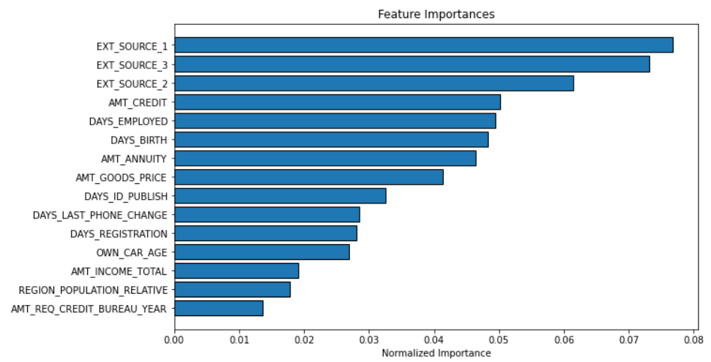
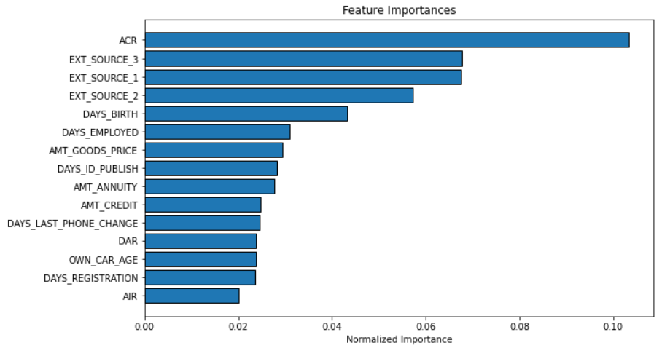
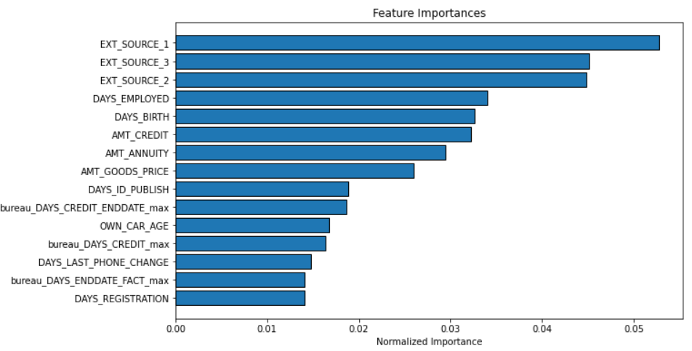
MODELING
LightGBM on raw Data
LightGBM with Domain knowladge features
LightGBM with Aggregated features

Slide 11
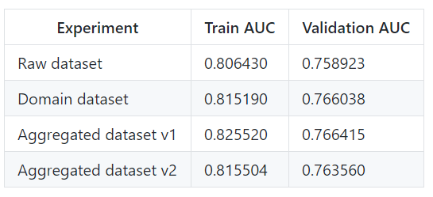
RESULTS
The metric we choose to evaluate our models is Receiver Operating Characteristic Area Under the Curve (ROC AUC, also sometimes called AUROC) due to the high unbalanced labels.
Home credit will face losses if the model prediction is wrong in two scenarios:
Scenario 1
Scenario 2
LightGBM 10 k-fold
If the model has predicted the client will repay the loan but actually he has defaulted
If the model has predicted the client will default but he can actually pay the loan back deserving candidate not getting a loan, bank loss in return interest

Slide 12
THANKS
Github repository: https://github.com/HebaAladdin/Kaggle-home-credit-risk

